Slide 1
VPR Programs
Dr. Jakob Jensen Assoc. Vice President for Research
jakob.Jensen@utah.edu

Slide 2
Introduction
AVPR Activities
Upcoming Events

Slide 3
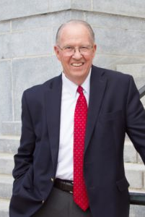
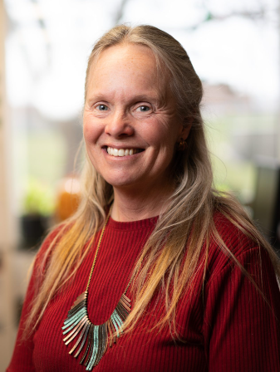
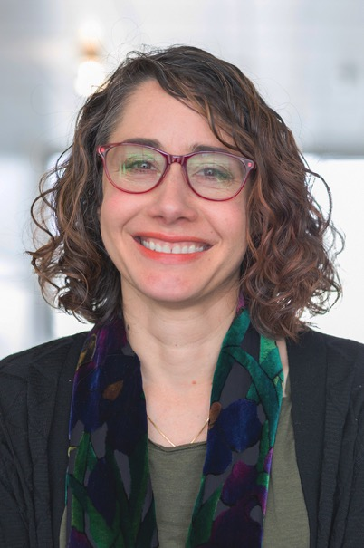
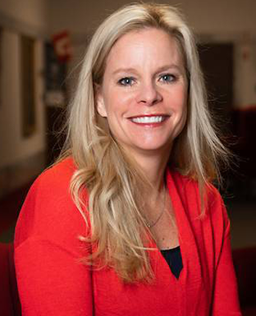
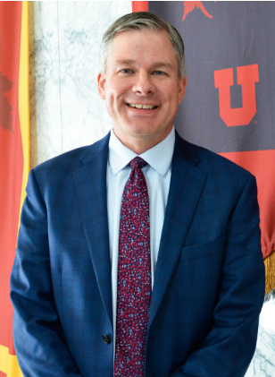
AVP for Research
Ronald Pugmire
1970-2009
Cindy Furse
2009-2019
Diane Pataki
2019-2021
Erin Rothwell
2021
Jakob Jensen
2022-present

Slide 4
AVPR Activities

Slide 5
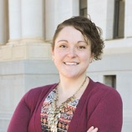
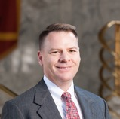
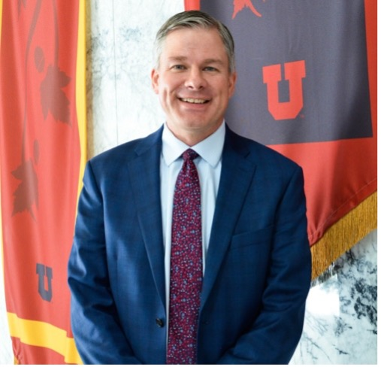
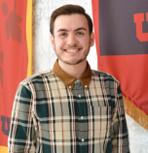
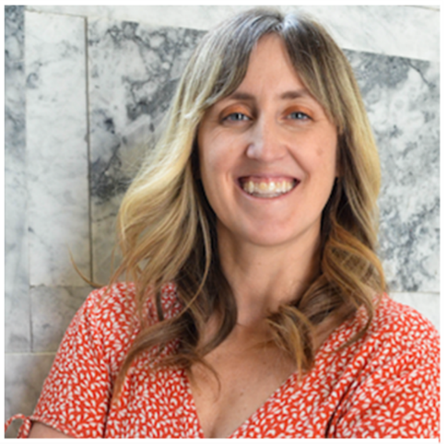
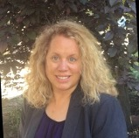
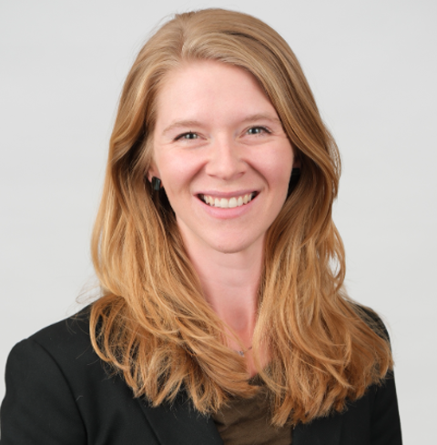
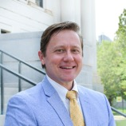
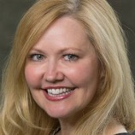
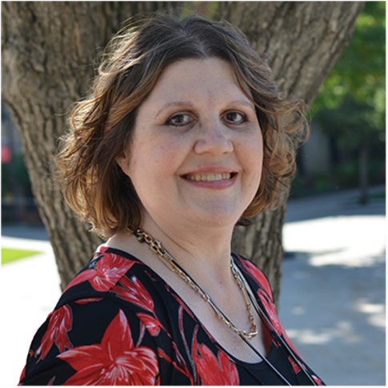
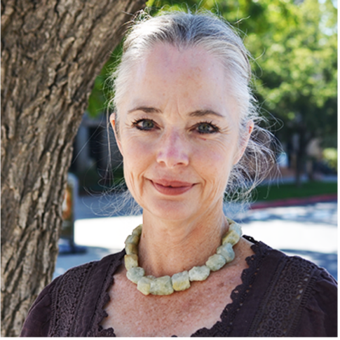
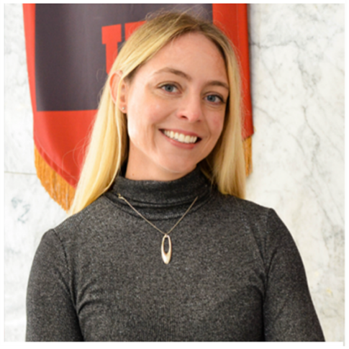
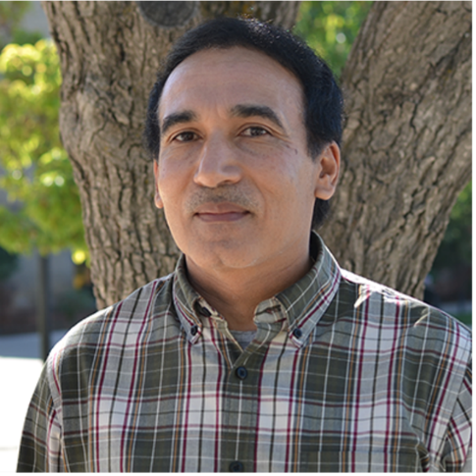
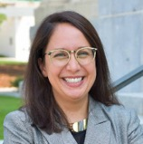
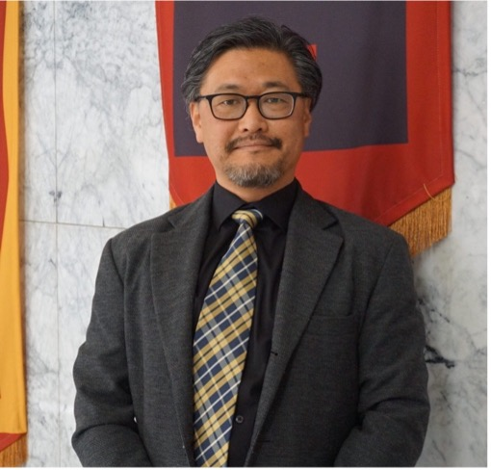
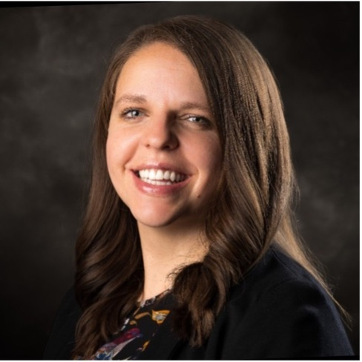

Slide 8
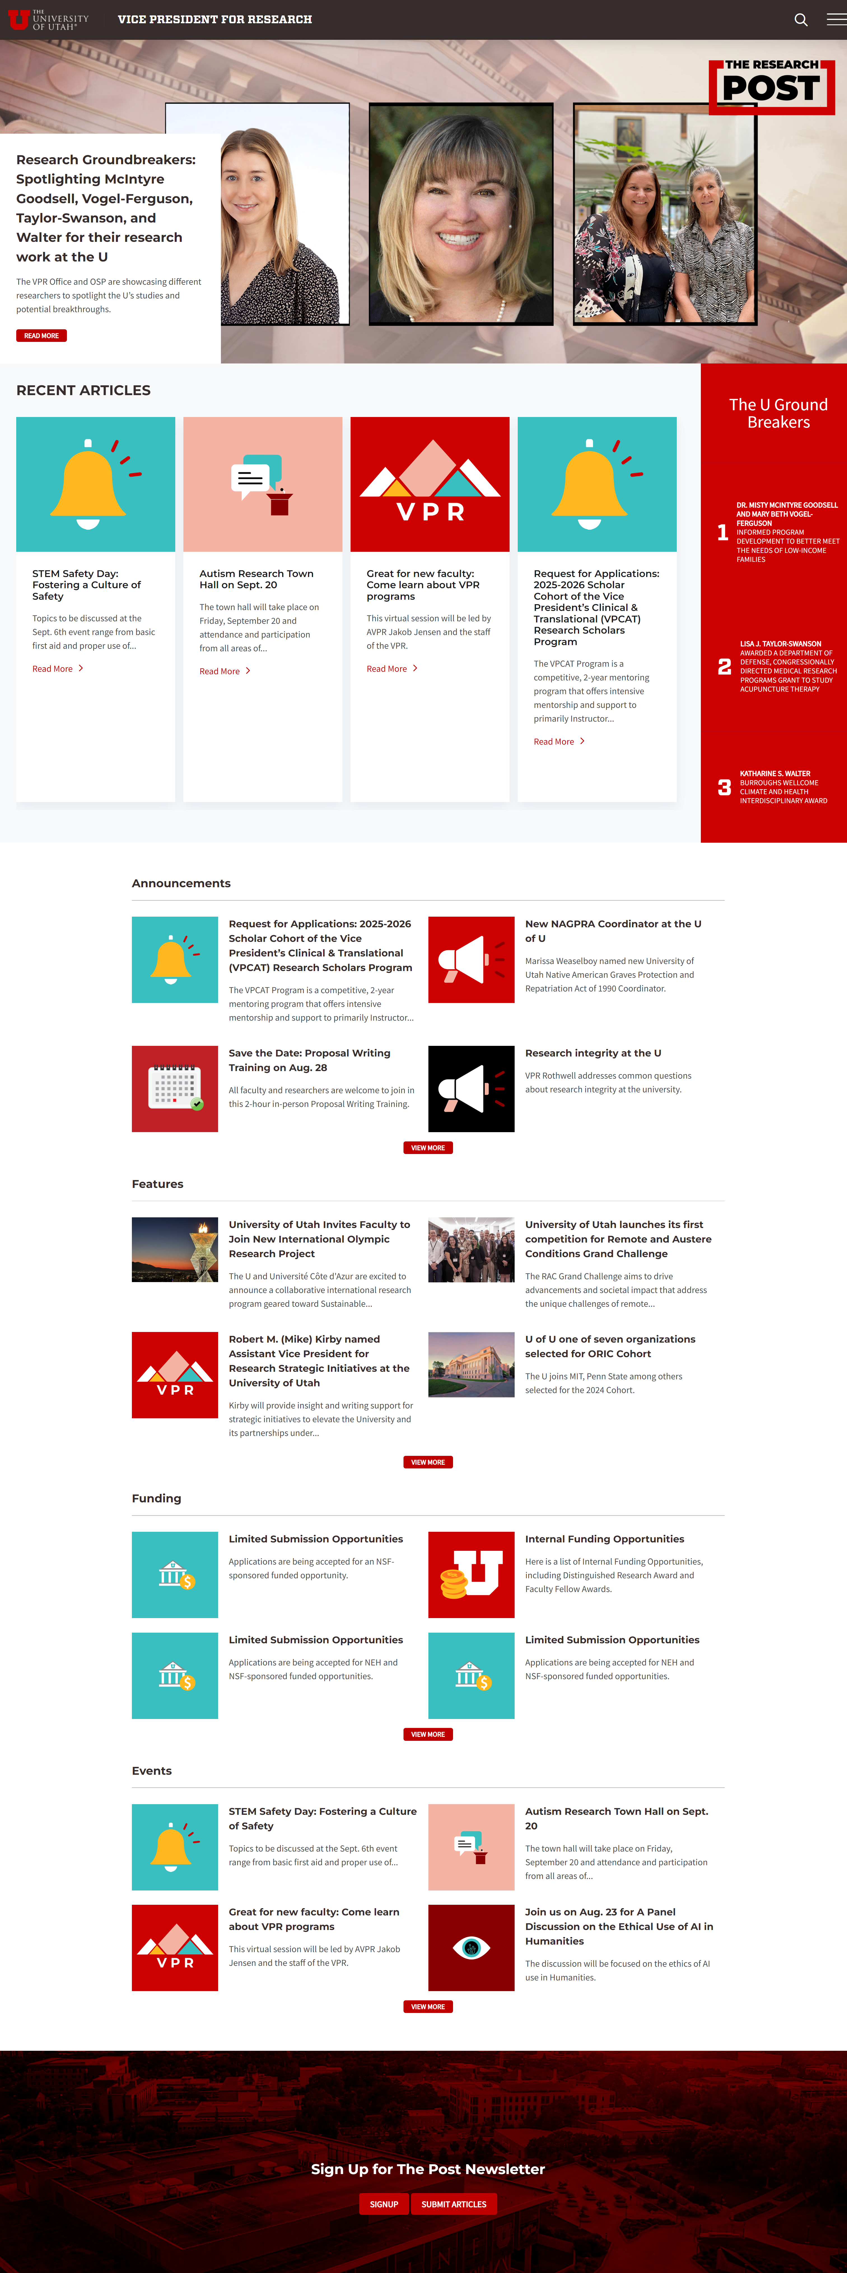
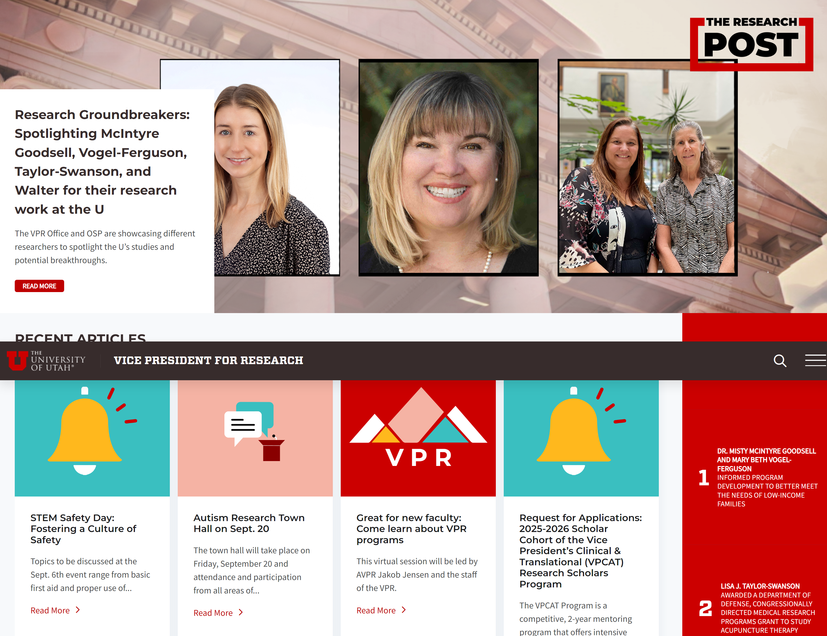
The Research Post launched in 2023. The Post is published every two weeks and can be read online or via an email newsletter. Sign up here.

Slide 9
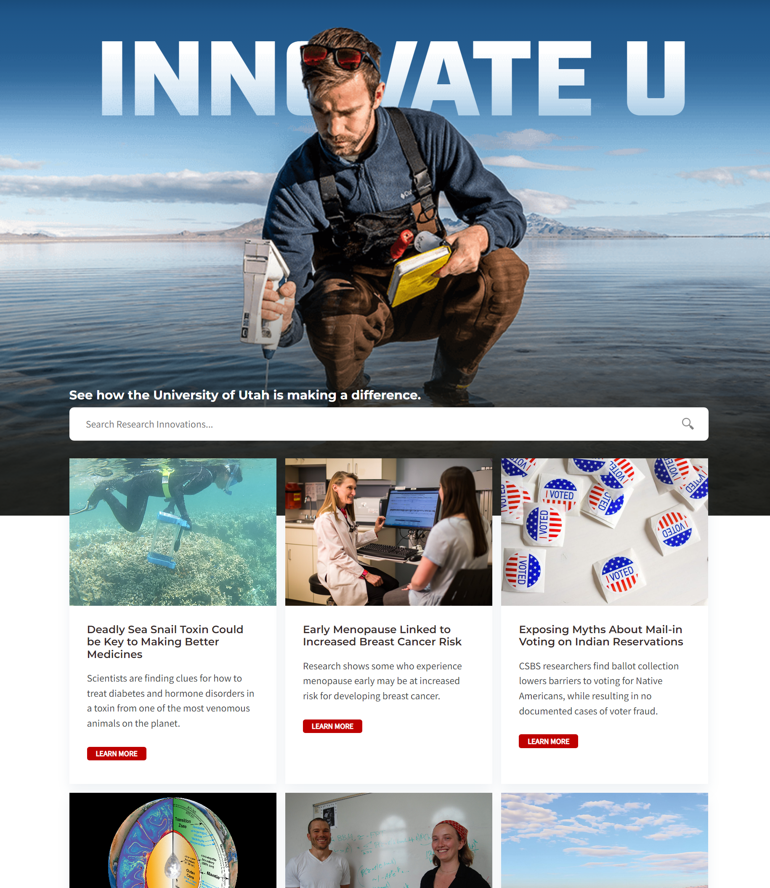
Innovate U launched in Spring 2024. You can view it here.

Slide 10
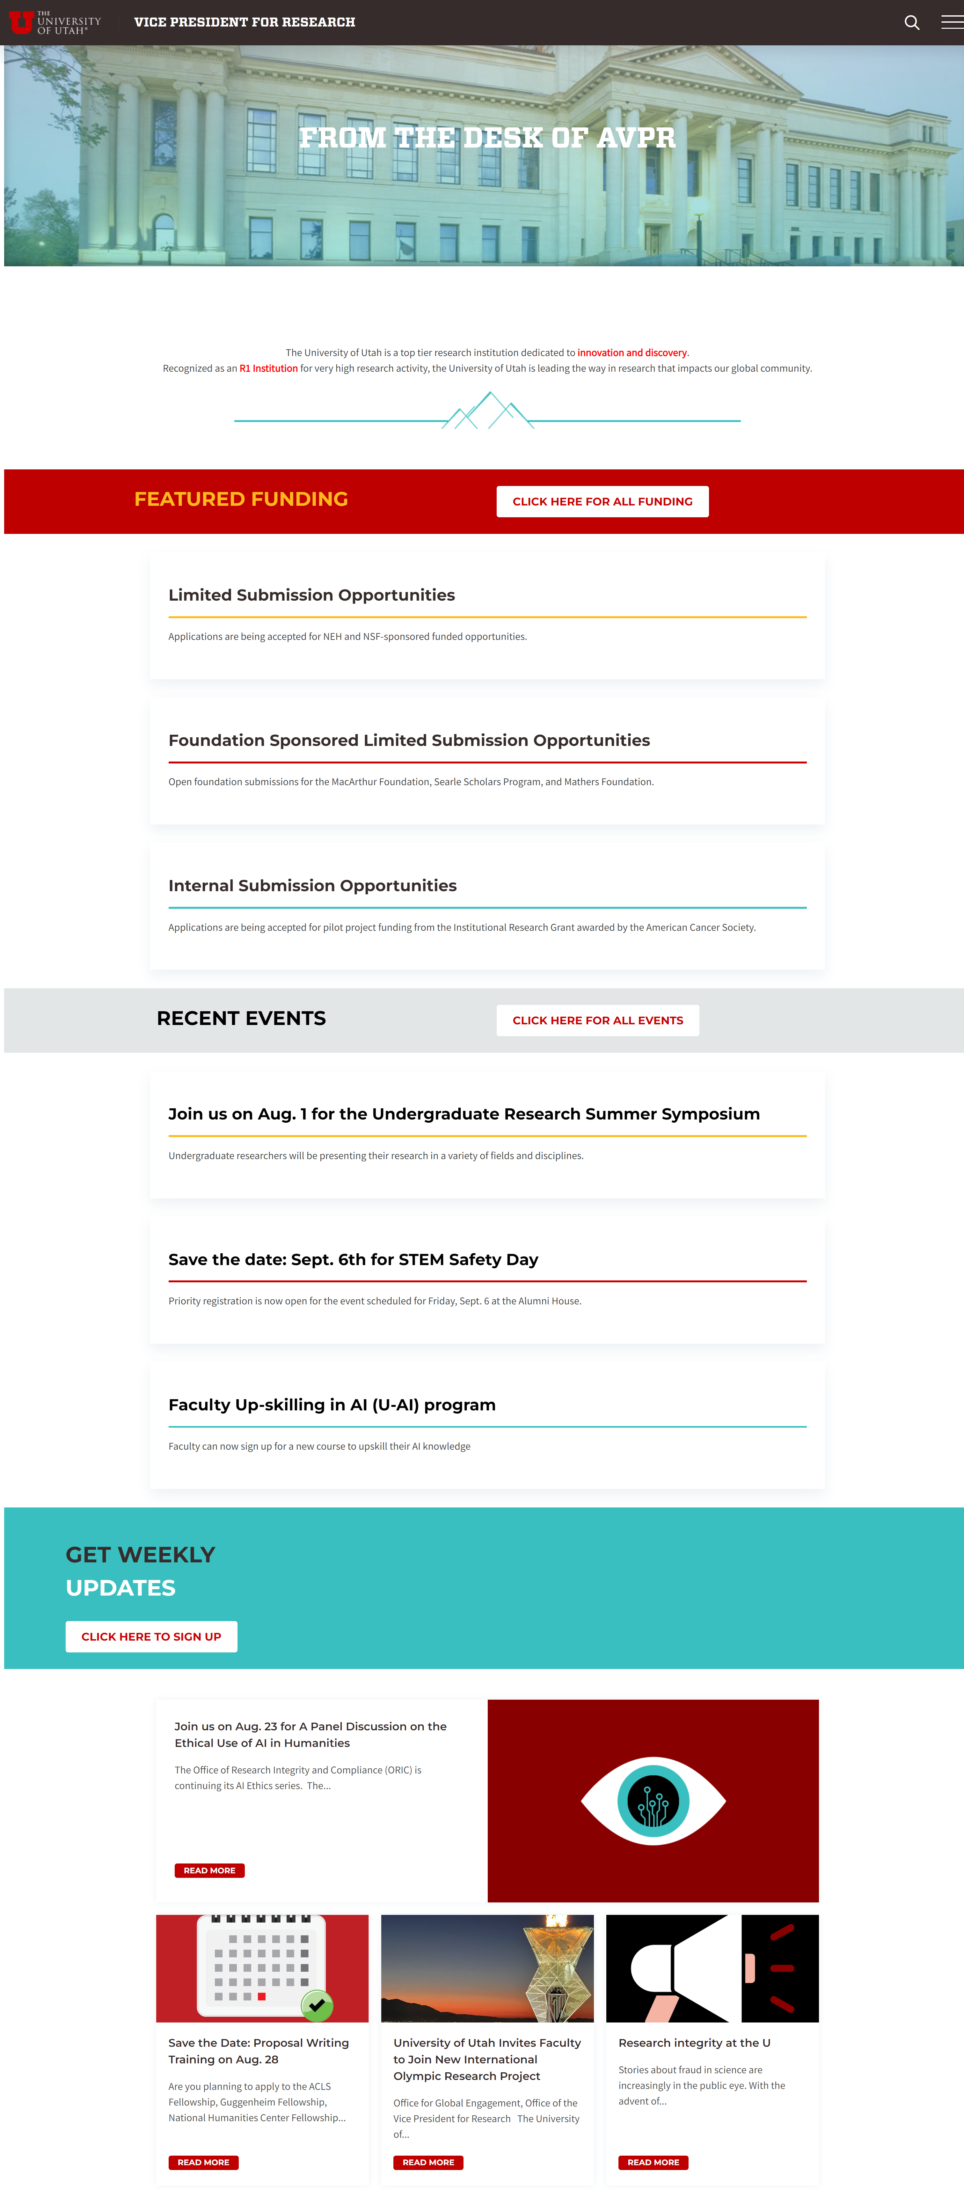
The AVPR’s Desk launched in September 2024. It features all VPR events and announcements in one “easy to find” place. Faculty can also sign up to receive bi-weekly recaps here.

Slide 12
OSP supports University of Utah faculty through effective management of extramural sponsored proposals and awards funded by federal and state agencies, foundations, and other public and private sources. OSP is primarily responsible for interpreting and ensuring compliance with University policy, proposal and award terms and conditions, and applicable federal and state laws and regulations. OSP reviews and submits proposals on behalf of the University. OSP also drafts, negotiates, and signs sponsored agreements and subawards.

Slide 13
The Pre-Award Office is to assist investigators with the preparation and submission of applications for extramural funding. Some of the services offered by the Pre-Award Office include researching the funding opportunity, starting and managing the application, providing instructions and checklists of requirements for the opportunity, reviewing all submission documents, assisting with budget preparation, and liaising with the Office of Sponsored Projects to submit the application. The Pre-Award Office currently serves specific departments and colleges across main campus and health sciences.

Slide 15
The AVPR chairs a few key committees: :
the One Utah Research Council (OURC)
the ADR Council
the University Research Committee (URC)
all review committees for VPR Internal Funding Programs

Slide 16
OneU Research Council (OURC)
Jakob D. Jensen
Stephen Stubben
Associate Vice President for Research
Associate Dean for Faculty and Research
David Eccles School of Business
Chair
Caren Frost
Teneille R. Brown
Associate Vice President for Research Integrity & Compliance
Associate Dean for Research &
Faculty Development
S. J. Quinney College of Law
Launched in 2022, the OURC provides direct feedback to the Vice President for Research (VPR) for research matters. The OURC will make recommendations to the VPR for strategic, cross-campus research infrastructure that:
Empowers the University of Utah campus community to lead innovative and strategic research efforts through shared resources and collaboration;
Informs, evaluates, and implements initiatives led by the VPR Office, and;
Supports efforts to establish the University of Utah as a top 10 Public University with unparalleled societal impact.
The OURC includes representation from across the university and is chaired by the Associate Vice President for Research (AVPR).
Rachel Hess
Becky Zarate
Associate Vice President for Research, Health Sciences
Associate Dean for Research College of Fine Arts
Julie Fritz
Mike Kirby
Darryl P. Butt
Associate Dean for Research
College of Health
Professor and Research Liaison
Khalert School of Computing
College of Engineering
Dean, Graduate School
Research Liaison,, Engineering
Annie Fukushima
Mary Ann Villareal
Keith Bartholomew
Associate Dean, Undergraduate Research
Research Liaison,
College of Transform
Vice President for Equity, Diversity, and Inclusion
Office of Equity, Diversity, and Inclusion
Associate Dean for Research
College of Architecture + Planning
Chris Hill
Meeyoung O. Min
Carol Lim
Vice Dean of Research
School of Medicine
Associate Professor
College of Social Work
Associate Dean for Research
College of Pharmacy
Tyler Matsamas
Robert Zheng
Isabel Moreira
Associate Director, Operations & Logistics for AVPR
Office of the Vice President for Research
Interim Associate Dean for Research
College of Education
Associate Dean for Research
College of Humanities
Manish Parashar
Andrea Rorrer
Pearl Sandick
Director
Scientific Computing & Imaging Institute
Director of Utah Education Policy Center
Professor, Educational Leadership and Policy
Associate Dean for Faculty & Research
College of Science
Harish Maringanti
Neli Ulrich
Rebecca Utz
Associate Dean for Research, IT, and Digital LIbrary Services
UofU Libraries
Executive Director
Huntsman Cancer Institute
Associate Dean for Research & Graduate Education
College of Social & Behavioral Science
Andrea Wallace
Brenda Heaton
Kevin Whitty
Associate Dean for Research
College of Nursing
Associate Dean for Research
School of Dentistry
Associate Dean for Research
College of Engineering

Slide 17
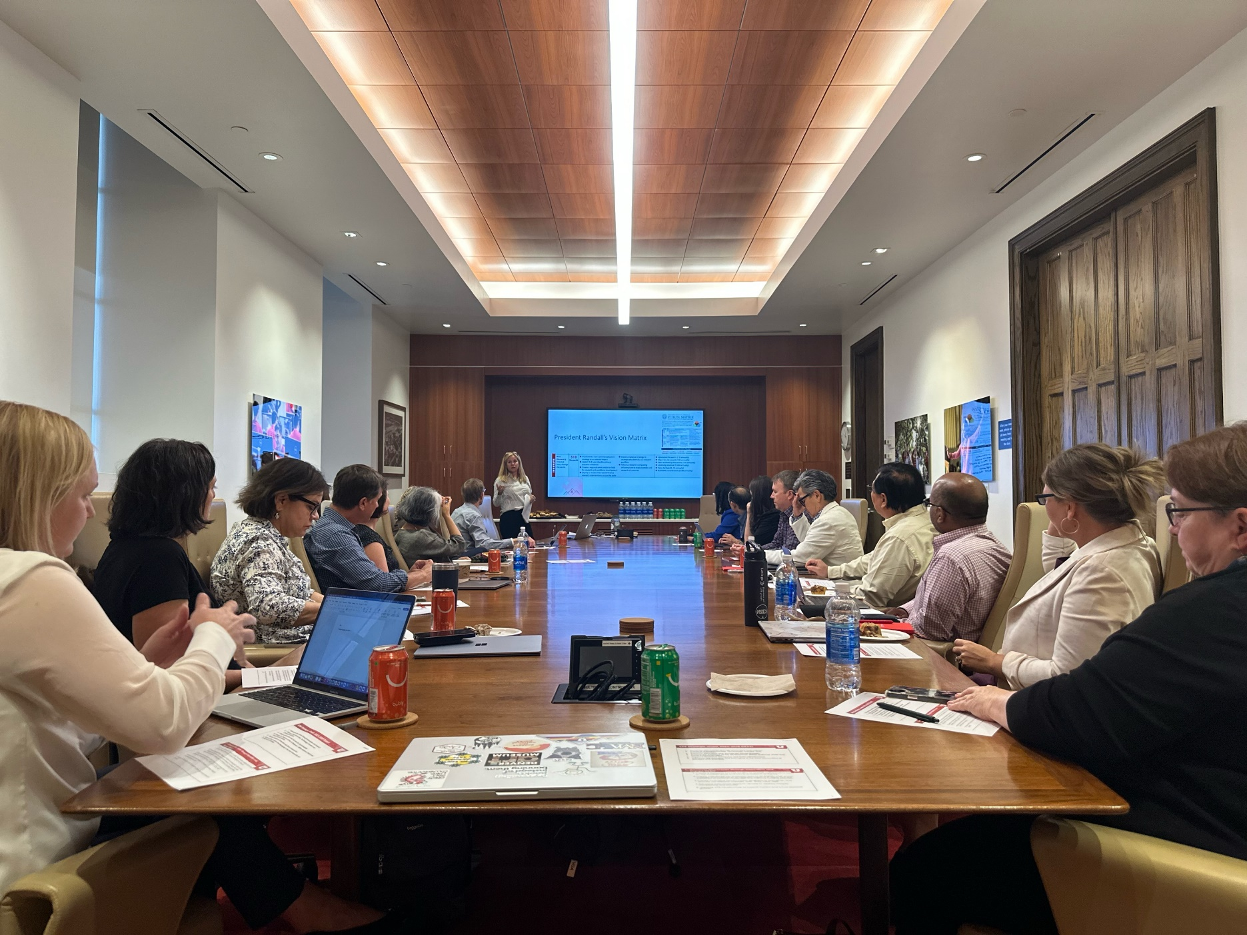
The AVPR meets regularly with ADRs across the university, and periodically brings the ADRs together as a council. ADR council meetings focus on research administration policy, initiatives, and activities.

Slide 20
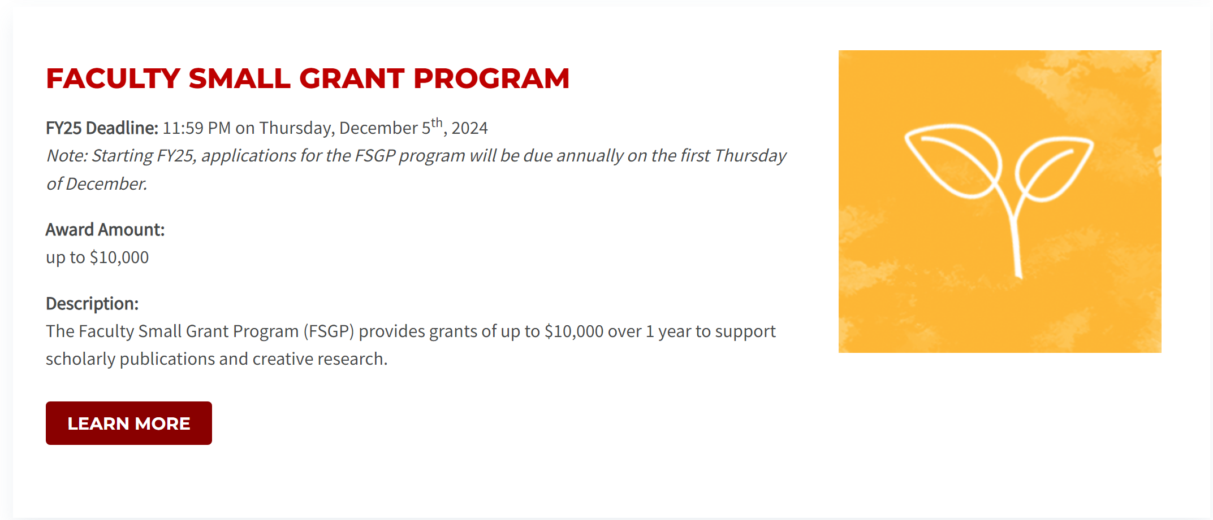

Slide 21
The Associate Vice President for Research operations staff manages a number of internal funding and award programs.

Slide 22
The Associate Vice President for Research operations staff manages a number of internal funding and award programs.

Slide 23
The Associate Vice President for Research operations staff manages a number of internal funding and award programs.

Slide 24
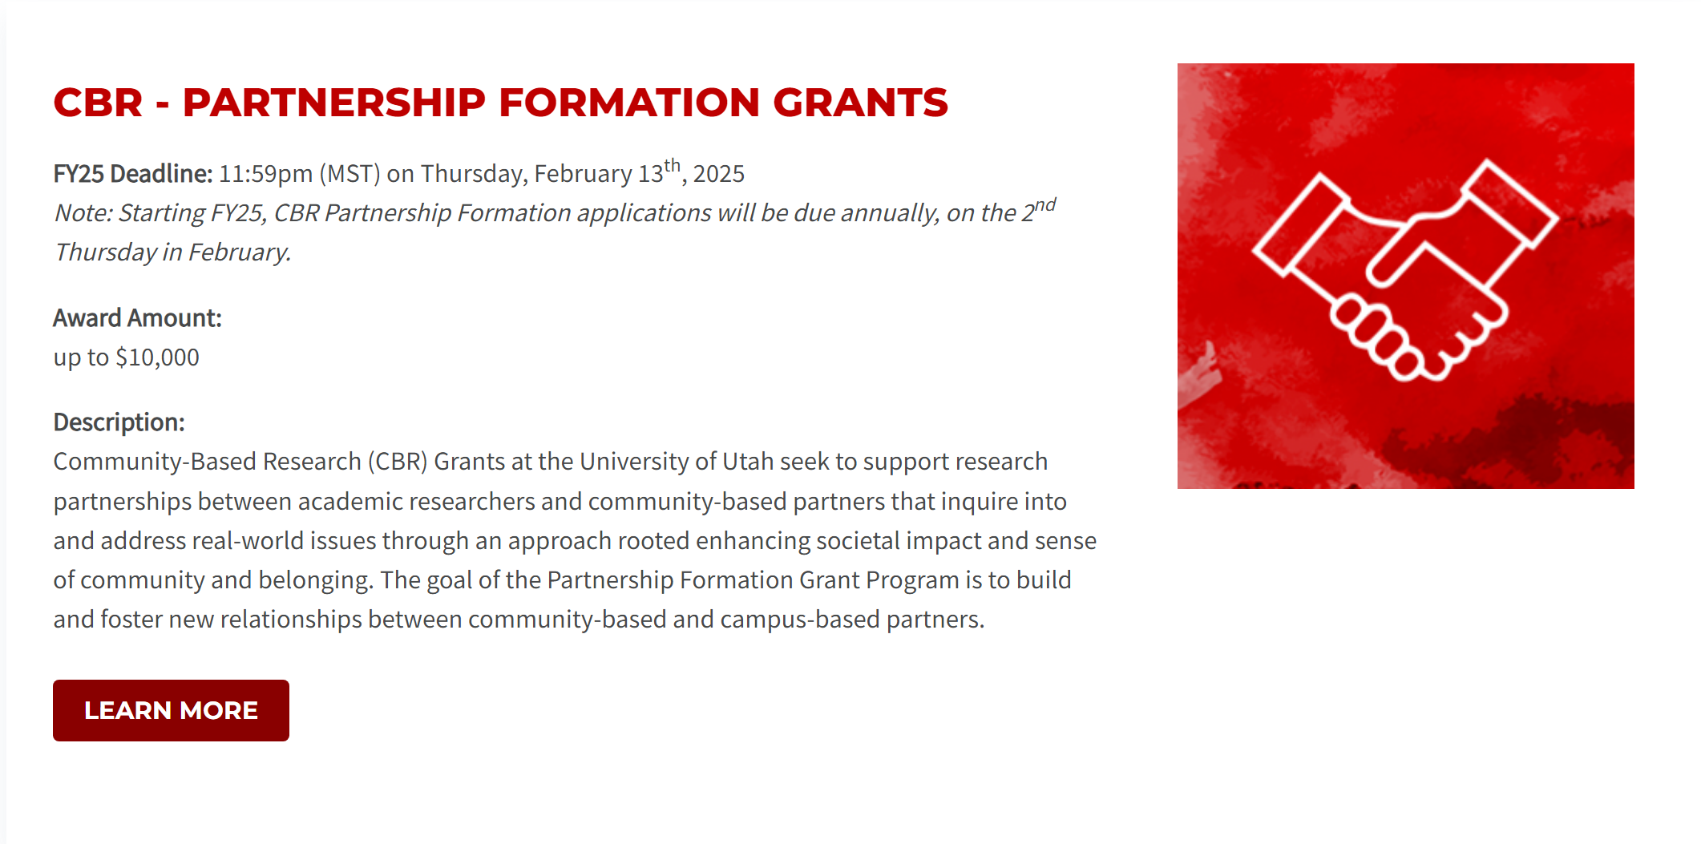
The Associate Vice President for Research operations staff manages a number of internal funding and award programs.

Slide 25
The Associate Vice President for Research operations staff manages a number of internal funding and award programs.

Slide 27
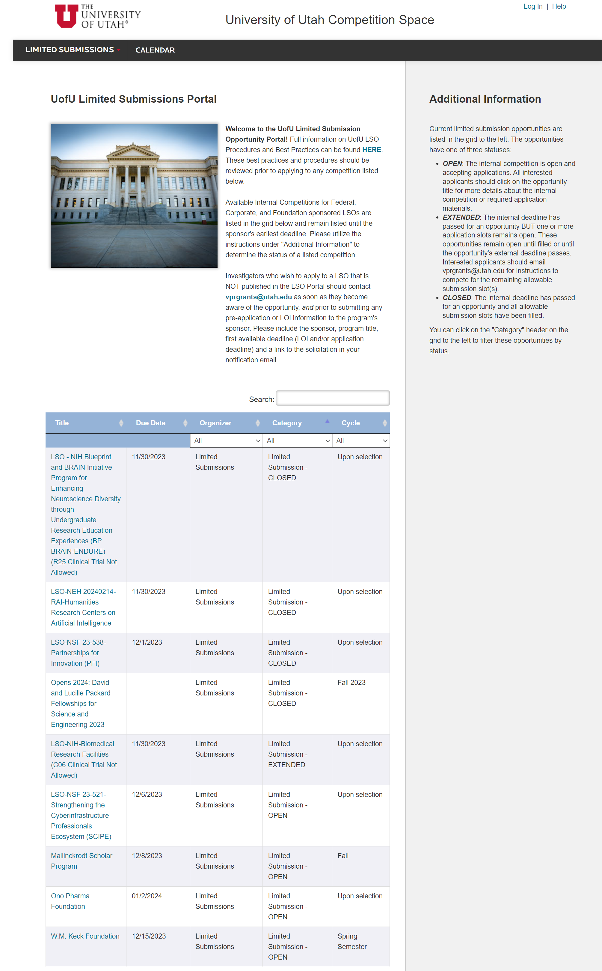
The AVPR oversees limited submission opportunities (LSOs) for the university. This involves posting LSOs to Infoready, communicating LSOs to the research community, managing the internal review processes, and selecting LSOs to advance.
In 2023, we launched an LSO listserv to facilitate more rapid communication of LSOs to our research community. You can sign up to receive those emails here.

Slide 29
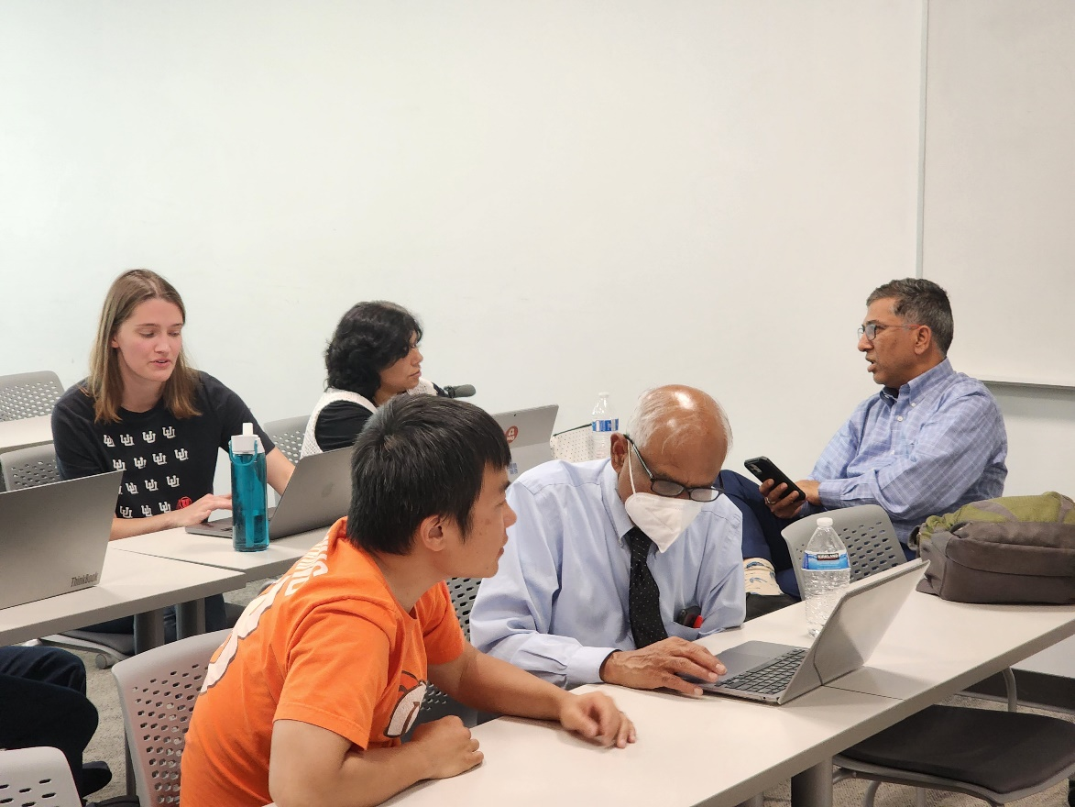
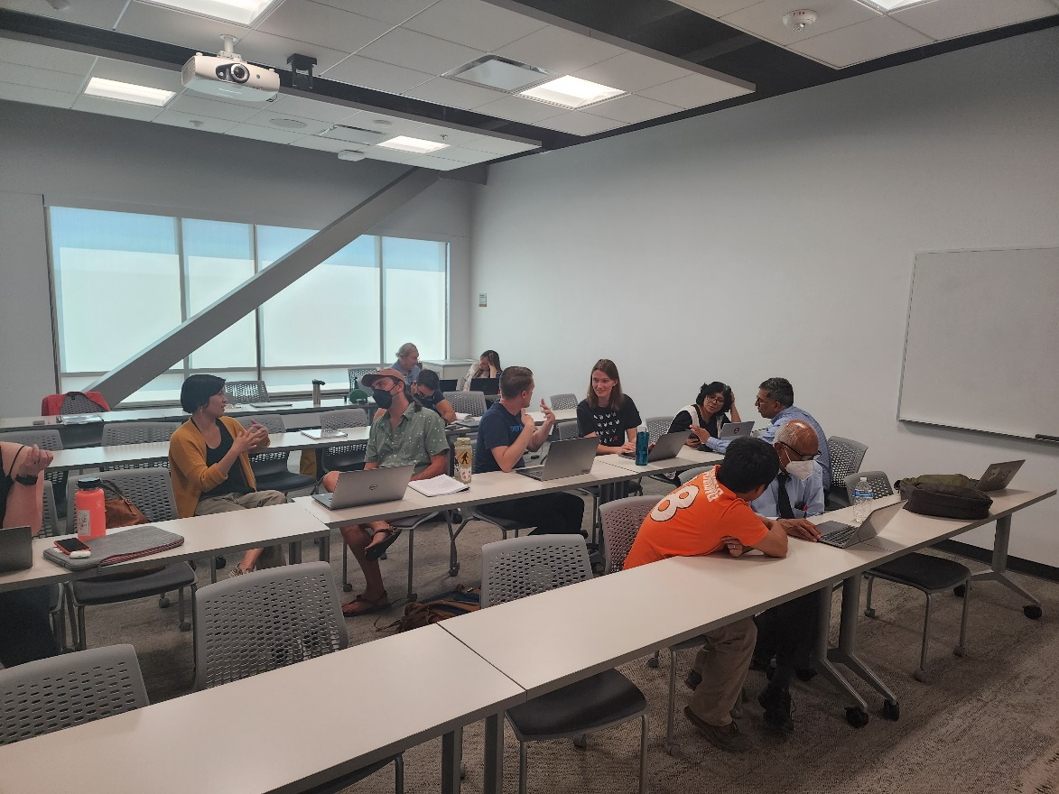
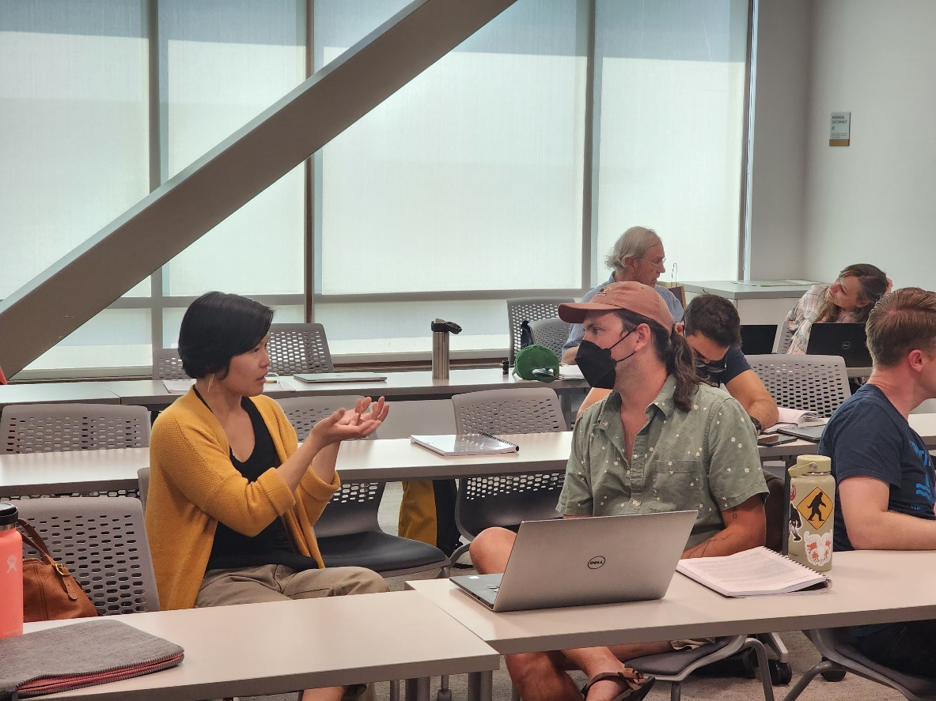
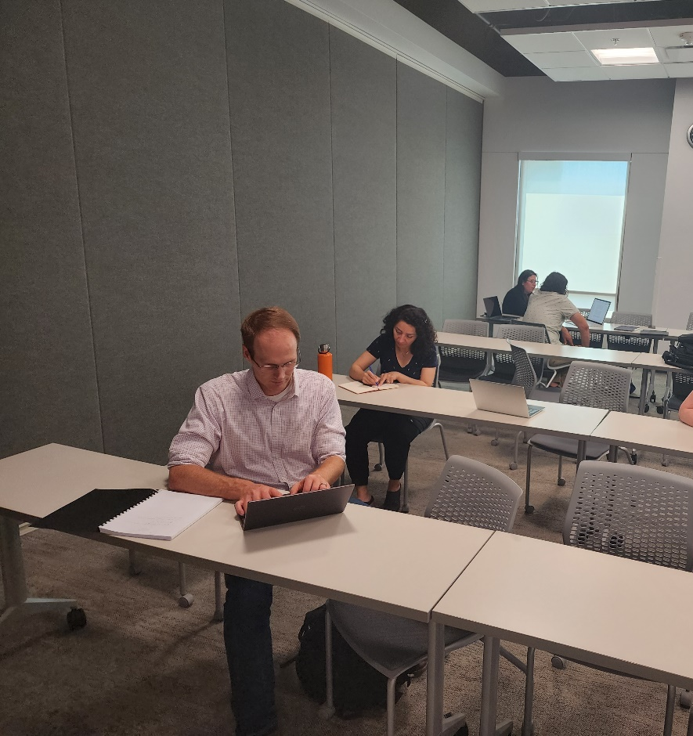
The VP-NSF Cohort Program (henceforth, “Cohort”) is a university-wide resource that provides up to twenty faculty with NSF-specific mentoring, skill development, and support. Faculty selected to participate in the one-year program will craft an entire NSF proposal with the objective of submitting the following year (and/or next cycle). The program is designed for both new faculty and those who are new to pursuing NSF funding.
Faculty who complete the Cohort program will finish with a complete NSF grant proposal that is ready for submission. Other potential benefit to faculty include:
Increased NSF funding for the University
Increased connections between/within colleges and units
Enhanced grant-writing skills and confidence
Development of future faculty mentors
A transferrable research summary designed to kickstart proposals for other grant opportunities (within and outside of the NSF).

Slide 30
Apply Now
The application portal opens every spring.
Faculty are required to complete the REd NSF Foundation Course before beginning Cohort and are strongly encouraged to complete the course prior to applying for Cohort.

Slide 31
What is LIFT?
The Large Infrastructure Funding Team (LIFT) was launched in August 2023. LIFT is designed to assist response teams for center, program, and large-scale grant opportunities. LIFT primarily provides grant writing support.
How to Request Support from LIFT:
LIFT does not charge for its services, but it does require a formal request for support. Researchers can submit LIFT requests here.
Director
Sara Salmon
LIFT Services:
Requests will be reviewed by the LIFT team and a decision will be communicated back to the requestor. LIFT does not have the bandwidth to support all requests. Key criteria for assessing requests include size and scope of the grant, support from corresponding colleges/branches/units, and long-term impact for the university. Requests for support can be made by the investigator, faculty, staff, or administration.
Senior Grant Writer
Erin Meyer
Senior Grant Writer
Elizabeth Gerhart
Grant Writer
Osama Yousef
Associate Director of Social Impact
Mercedes Ward
Example LIFT support:
NSF Global Center, EDA Tech Hubs, NSF Biofoundries, NIH Climate Change and Global Health Center, DoE Advanced Processing of Critical Minerals, NIH Centers of Excellence of Total Worker Health, EPA Solar for All, NSF ERC, NIH COMPASS
Senior Graphic Designer
Tara Mleynek

Slide 33
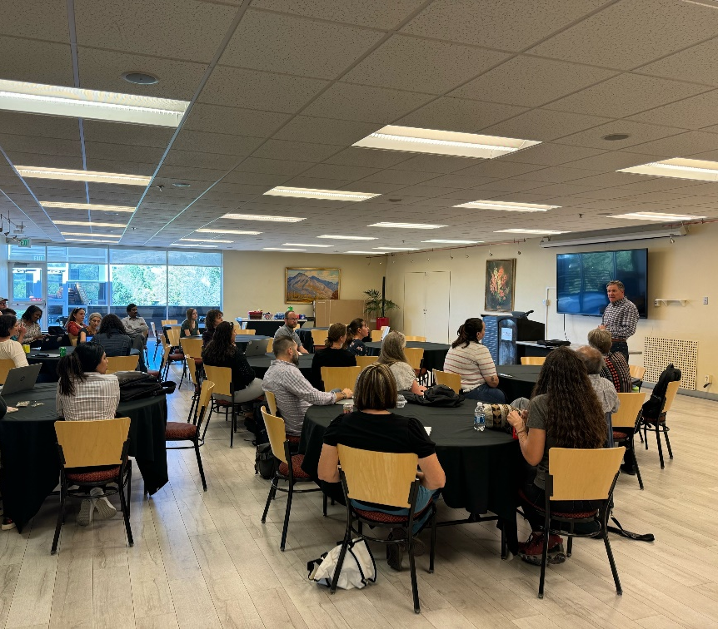
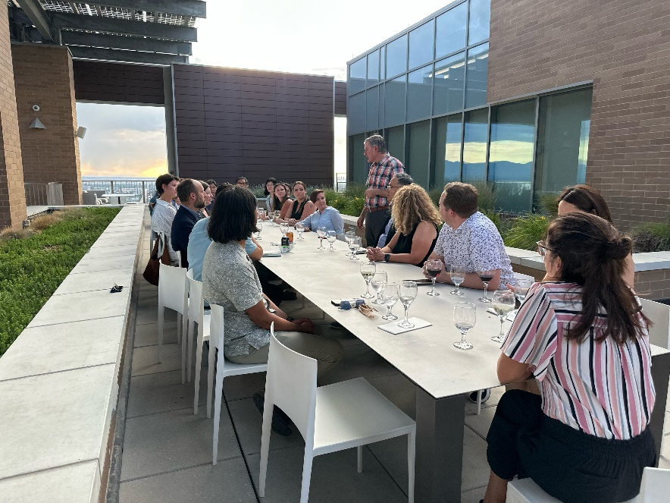
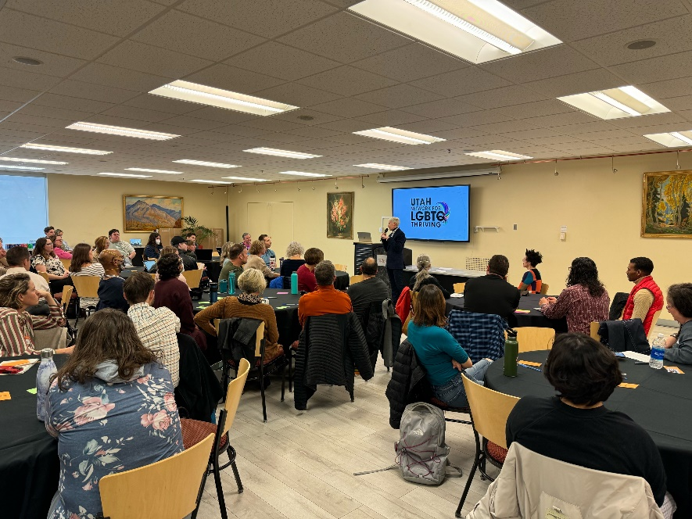
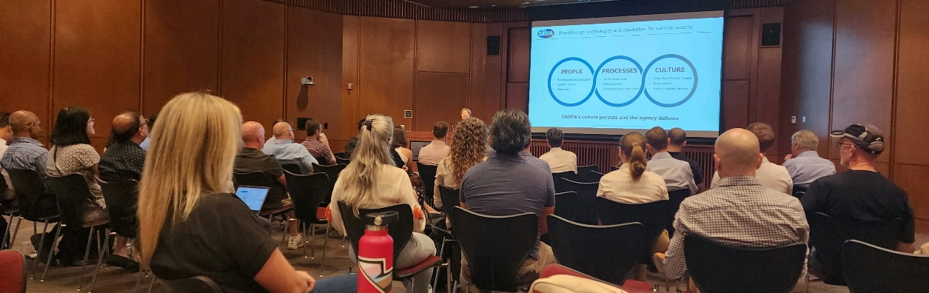
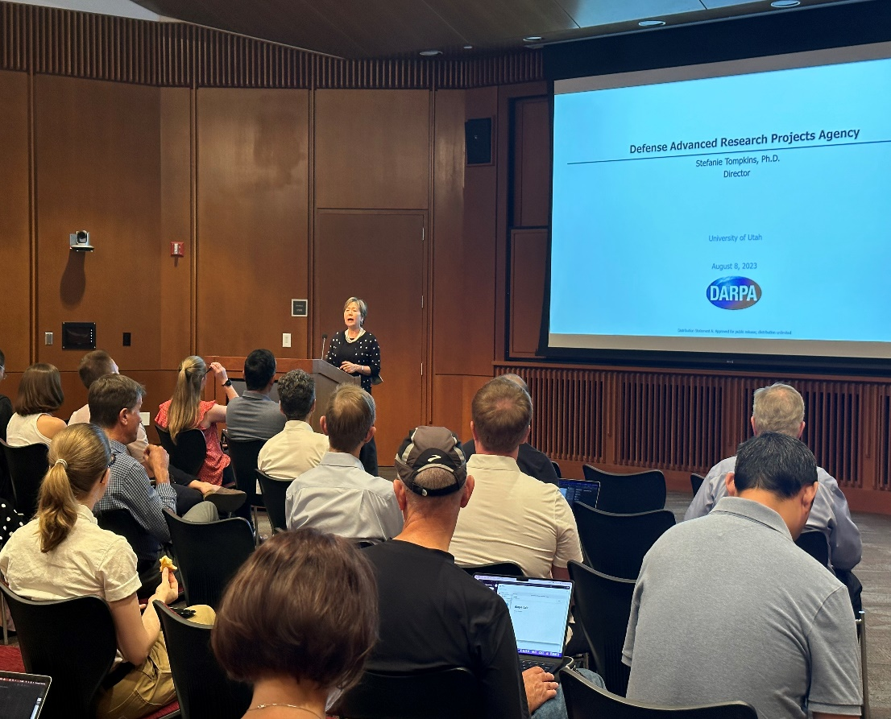
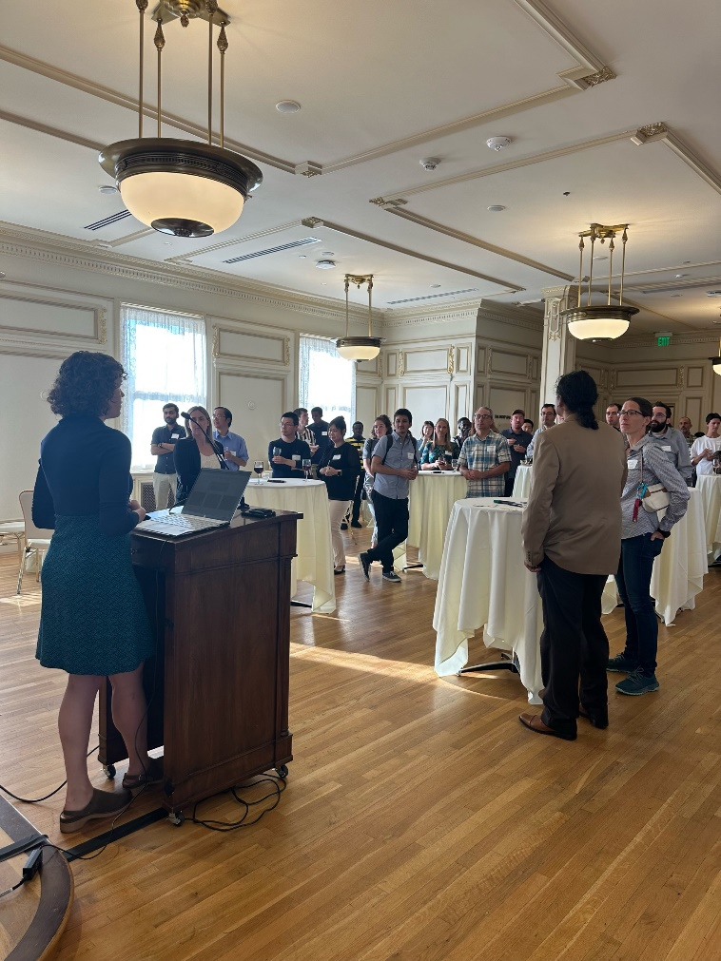
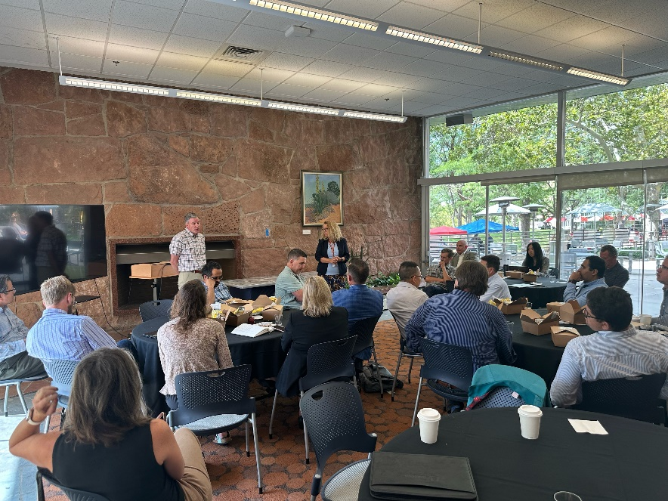
The AVPR engages in numerous research development activities, including overseeing internal funding programs, cultivating external program and center grants, arranging for program officer visits, and collaborating closely with other campus offices such as Corporate and Foundation Relations, HSC Strategic Initiatives, etc. to drive the research mission of the University of Utah.

Slide 34
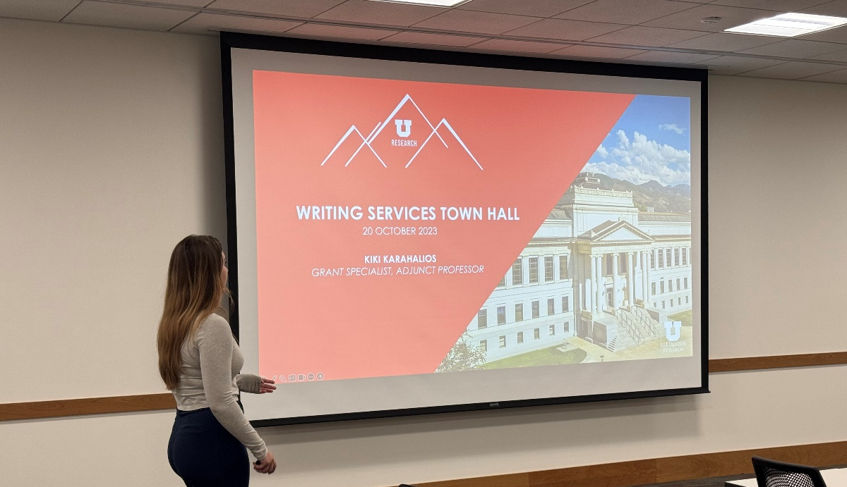
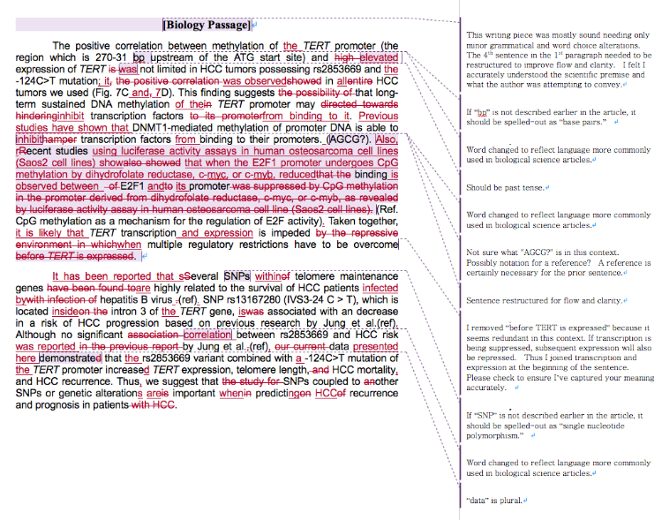
The VPR Office recently hired Kiki Karahalios, Grant Specialist, to provide research writing support, workshopping, and training opportunities for faculty. This effort will:
Support faculty in reviewing and editing research narratives for external funding, fellowship, and award opportunities.
Strengthen grant applications through editing and style support services.
Help the UofU obtain funding by creating and enhancing writing education, training, and best practices for grant applications.
Build a culture of top-tier writing practices through ongoing peer-to-peer support, workshopping, and feedback on faculty writing trends.

Slide 35
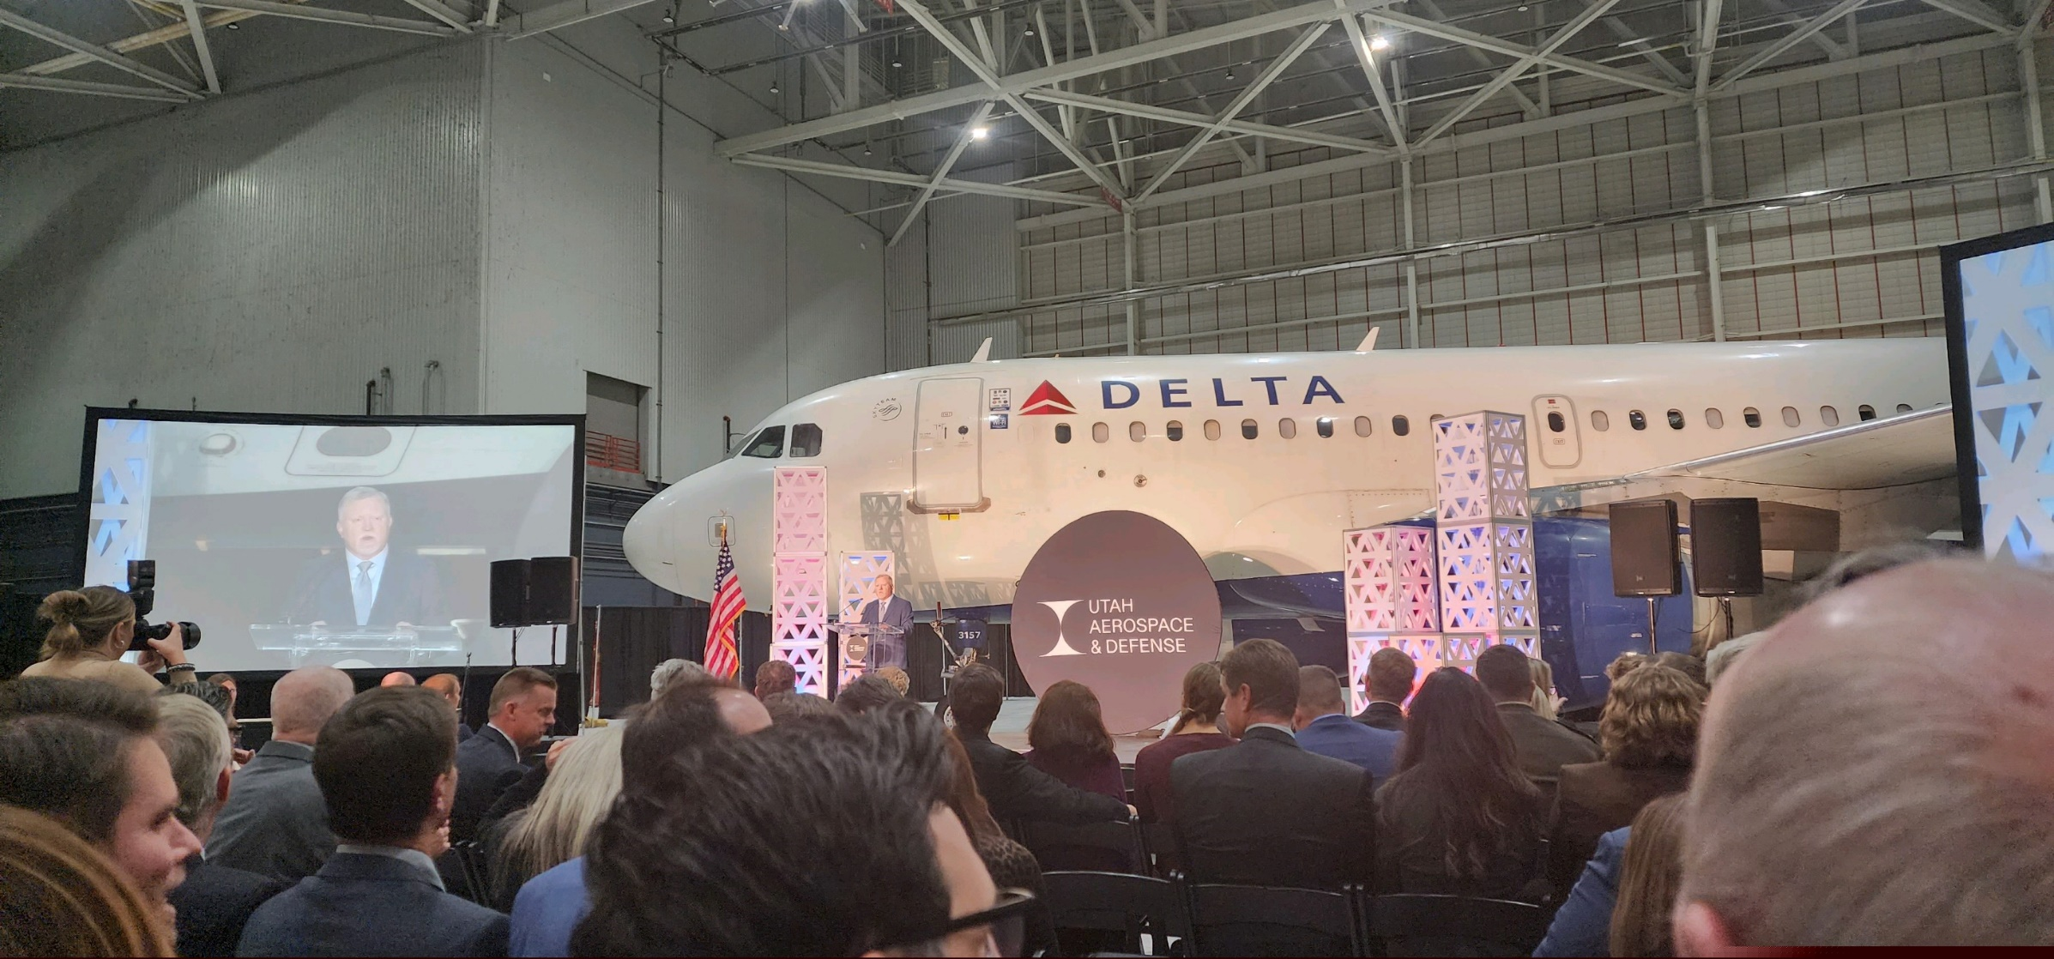
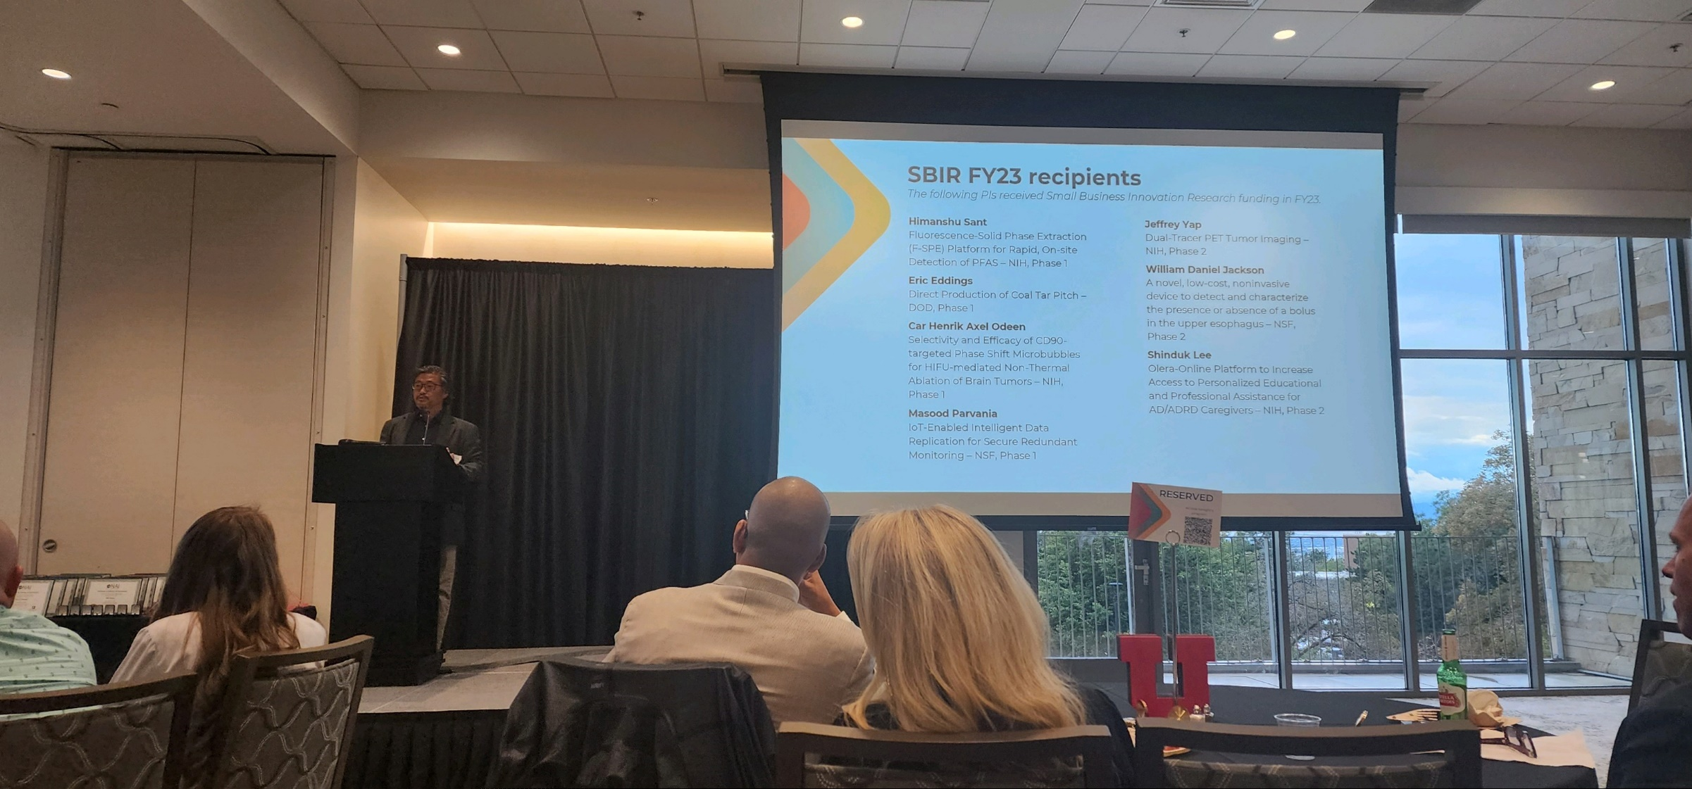
The AVPR supports research translation by cultivating relationships with industry and supporting research translation grants (e.g., SBIR/STTR).

Slide 36
One Utah Activities

Slide 38
1U4U Seed Grant Program
The 2024 1U4U topic was: “The Future of Sustainability.” Sustainability is achieved whenever the needs of the present can be met without sacrificing the needs of future generations. At the University of Utah, faculty have engaged sustainability across a wide range of domains, including environmental, social, communal, health, economic, technical, and legal. Indeed, sustainability is a foundational goal that cuts across multiple topics (e.g., healthcare, water, energy, wildfire, critical minerals, education, food security).
The theme of the FY25 program is “Women Across the Lifespan: Health, Technology, & Society.” Research projects should focus on expanding knowledge of women across their lifespans, which includes the study and analysis of issues specific to women, issue that disproportionately impact women, and issue that affect women differently. The goal is to pioneer the next generation of discoveries across a wide range of intellectual domains and areas of inquiry.
The 1U4U theme is identified each year by the SVPs based on feedback from two research councils: the One Utah Research Council (OURC) and the Health Sciences Research Council (HSRC). Faculty interested in shaping future themes should reach out to their representatives on one or both councils.
Full details (guidelines, eligibility, etc.) and application link for the FY25 program are provided on the program webpage. FY25 applications are due on or before 11:59pm on Thursday, February 27th, 2025.

Slide 39
1U4U Seed Grant Program
The VPR recently explicated a new process for the 1U4U Seed Grant program.
It will make the timeline more predictable to facilitate faculty engagement and increase cross-university conversations.
The new process articulates activities for both the current cycle and for the next cycle.
The idea is to position 1U4U as a catalyst for cross-university conversations.
Notes:
This raises interesting questions...
inaccurate information (misinformation, disinformation, and conspiracy theories)
a desire to be right: Initial messaging conveyed unwarranted certainty, e.g., about causes, preventive measures, and how much time it would take to flatten the curve. (could just say this aloud)
Reasons for neg fx? We’re trying to figure out what the lesson is. trying to identify the features of that situation that …. Led to a meaningful difference… it may or may not extrapolate to other contexts, might extrapolate to future pandemics or situations with long term instability. It’s definitely a lesson we have to learn and have infrastructure for. Have a system for beforehand. Be disciplined. Dont abandon our plans.

Slide 41
Learn more here.

Slide 42
Learn more here.

Slide 43
Upcoming Events

Slide 44
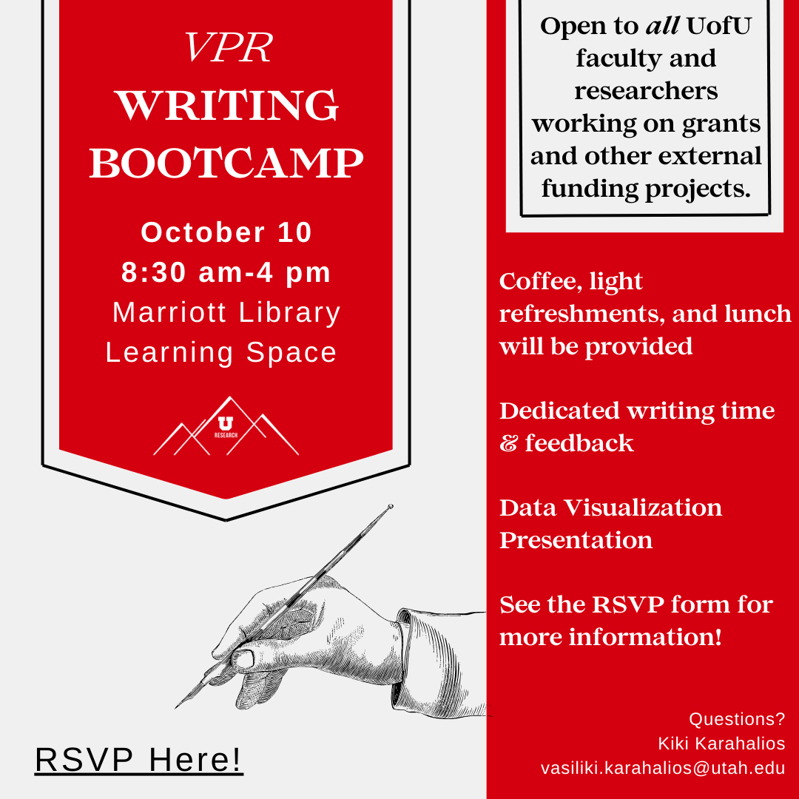
The VPR Writing Bootcamp is a new concept designed to offer time, resources, and writing community for all faculty and researchers applying to external funding organizations. All faculty and researchers are welcome!
The primary purpose of this event is to reserve dedicated time on your busy calendars to work on your extramural funding proposal. Bring your laptop or writing materials to thoughtfully write, edit, revise, and bolster your proposals in companionship with other campus community members. In addition, Kiki will provide 1:1 writing consultations to review the specifics of your proposal. This time can be used to answer questions, find resources, provide advice, and evaluate draft documents. Finally, Kaylee Alexander (Assistant Librarian) will present on how to transform your proposals with compelling data visualizations. This insightful presentation will show you how to effectively visual tools to communicate your project's impact, goals, and outcomes effectively. This is an opportunity to learn how to enhance your storytelling to increase your chances of securing funding!
Coffee, lunch, and light refreshments will be provided. Space is limited - please reserve your spot by September 30, 2024. Those who RSVP will receive a detailed schedule.
RSVP: https://forms.gle/5mdmJdmzkLcQfpus5
Contact: Kiki Karahalios, vasiliki.karahalios@utah.edu

Slide 45
Learn more here.

Slide 46
Remote & Austere Conditions (RAC) Grand Challenge
30 Teams applied first year; 16 presenting at the July 19th pitch competition
12 judges from Air Force Research Laboratory, Special Operations Command, DARPA, NSA, Stryker, and others
250k seed grants
FY2025 Proposals due: November 14, 2024
What are Remote & Austere Conditions?
The U.S. Army defines remote and austere conditions as “environments where access to clean water, electricity, and to a fixed or mobile medical facility is significantly degraded or denied, and where diagnostic and treatment resources and medical personnel are unavailable or limited for extended periods of time.” These conditions are common in frontier counties, areas with less than 20 people per square mile and a travel time of at least 30 minutes to basic services. Approximately 56% of the U.S. is frontier and the majority of that is concentrated in the intermountain region.

Slide 47
Communities are key to fostering health and wellness. Working in community with people who share priorities, interests, and values can have a profound impact on our lives and help us develop a sense of belonging and identity.
Researchers at the University of Utah uniquely understand and demonstrate the value in partnering with and serving our local, national, and global communities. Significant impact comes when we integrate research and community strengths that focus on whole of community and human-centered solutions to health promotion and disease prevention. This includes an eye to physical, social, and mental health.
To that end, we invite all faculty, research staff, and researchers are invited to a 1-hour virtual brainstorming session and town hall to consider the formation of a University of Utah Community and Preventative Health research initiative. An initiative focused on Community and Preventative Health research would help researchers across campus explore resources, opportunities, and funding related to shared interests and goals in the community and preventative health research. Learn more here.

